Slide 1
Insult Detection in Social Commentary
Chirag Khurana MT17010
Pallavi S. rawat MT17034
Shubham Goyal MT17055

Slide 2


Introduction
The main area of focus in our project is to detect if a comment or a remark in a post or in a conversation is insulting or not.
The goal is to create a classifier which could operate on a variable test set to do classification with good performance.

Slide 3
Application & future scope
It can be put to use in blacklisting abusive users, child-safe web crawling, filtering in websites or webpages.
This application can further be projected in Detection of graphic insults (I.e. meme insults, or mentioning someone in comments of a meme)

Slide 4
DATASET:
- Twitter comments
- Diverse variety
- The dataset has 5000+ comments.

Slide 5
Evaluation & Ensembling
Classification
Data Extraction and selection
Preprocessing

Slide 6
Resources added:
sortedBadWords_for_checking.txt
Sorted collection of bad words and phrases. (self-compiled)
Train_features.csv
It is a train.csv + features file that has the computed value of the features.
(code- computed)
ConvertedBadWords.txt
Word Collection to clean file of misspelling escapes.

Slide 7
Pre Processing
removing extra spaces(\n,\s etc.),
url removal,( Eg https://www……)
html tags removal (Eg. <br> <H> etc )
word correction-level 1( coool to cool),
word Expansion, (Eg . u -> you)
Special Character tagging (Eg. *$@# -> TOKEN)
bad Word Correction -level 2 ( Gaarbagee -> garbage)
Result (without preprocessing):
Result (after preprocessing)-

Slide 8
Feature Extraction
Term Frequency- Inverse Document frequency
word-grams
Character n-grams
Capital Word ratio sentence length
Curse word ratio sentence length
Curse word ratio positive word
Short sentence ratio total sentences
Lexical score -Distance
Lexical Score -Dependency

Slide 9
Performance with addition of Features:
Term frequency
Word-n-grams
Inverse Document Frequency
Character Grams
0% |  |  |  | 100%

Slide 10
Classification
We had tried
various classifiers, simple neural Net ,even Multilevel classification using neural Nets with single hidden layer for classification task.

Slide 11
Models Used :
Multinomial Naive Bayes
Stochastic Gradient Descent
SVM Classifier
Logistic Regression
MLP classifier(Neural Network)
Finally used:
SVM Classifier
Logistic Regression

Slide 12
Variations in results with different classifiers:
Naive bayes
SVM Classifier
Gradient Descent
Logistic Regression
0% |  |  |  | 100%

Slide 13
Evaluation
Accuracy
Confusion Matrix
Area Under the curve

Slide 14
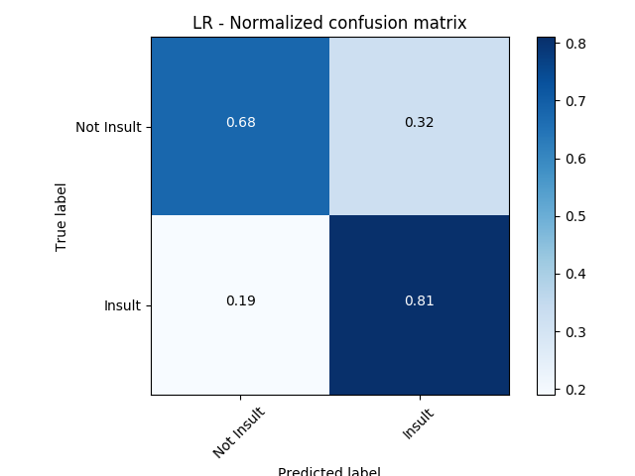
Confusion Matrix- LOGISTIC REGRESSION

Slide 15
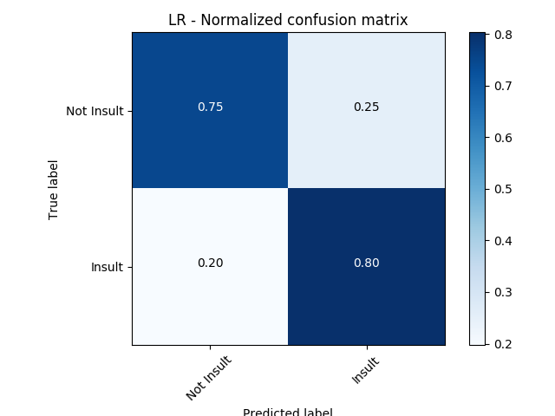
Confusion Matrix- LOGISTIC REGRESSION 2

Slide 16
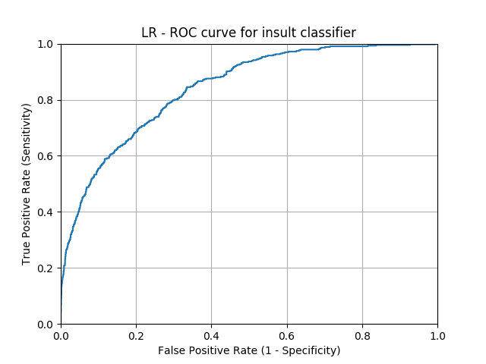
AUC - LOGISTIC REGRESSION

Slide 17
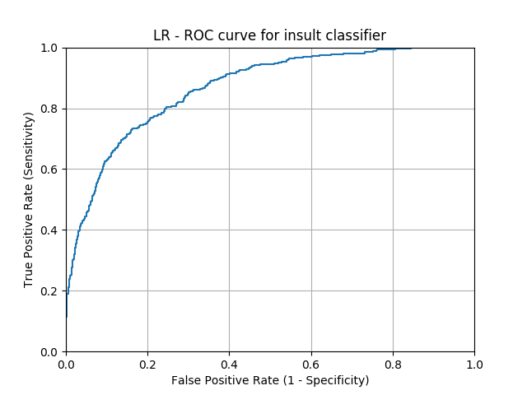
AUC - LOGISTIC REGRESSION -2

Slide 18

Confusion Matrix- Naive Baiyes

Slide 19
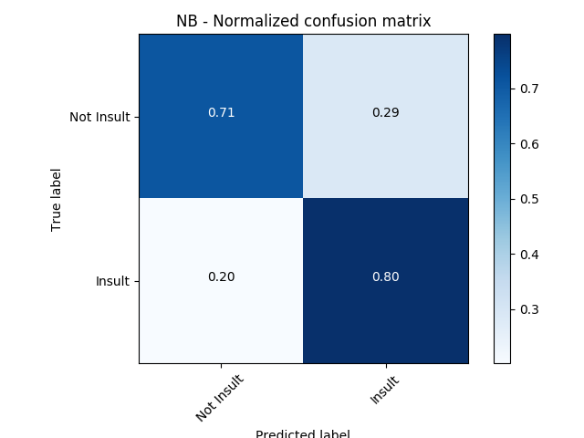
Confusion Matrix- Naive Baiyes 2

Slide 20
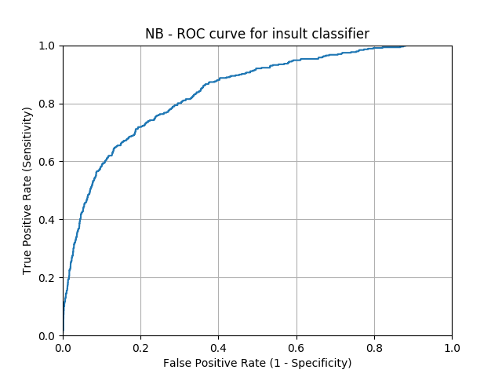
AUC - Naive Baiyes

Slide 21
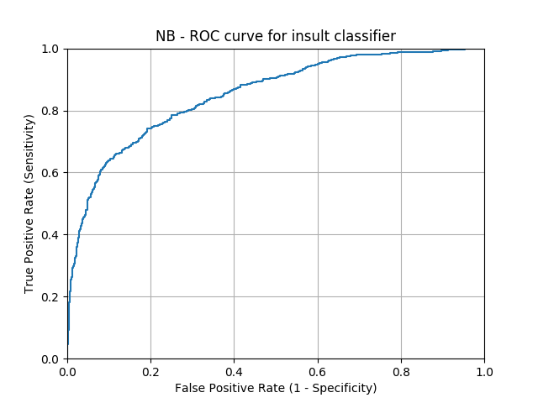
AUC - Naive Baiyes -2

Slide 22

SVM- Confusion Matrix

Slide 23
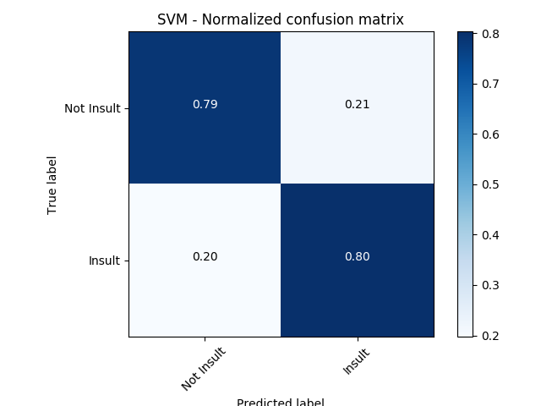
SVM- Confusion Matrix-2

Slide 24
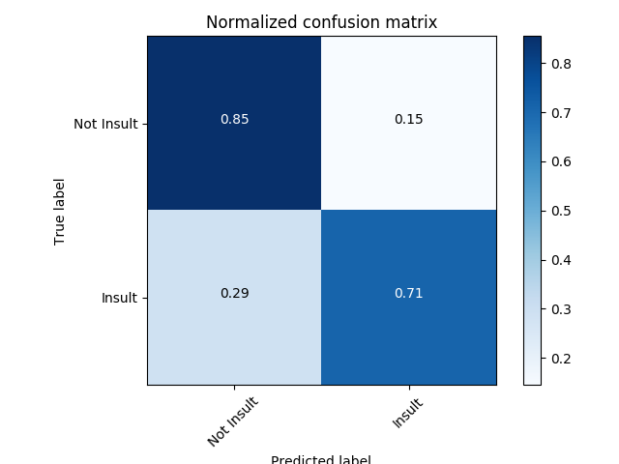
ENSEMBLING:

Slide 25

ENSEMBLING 2:

Slide 26
Takeaways & Learning Outcomes:
We have not used neural networks in our project , for two reasons, firstly , for 1000,400,700 neurons and 1-3 hidden layers the accuracy touched 79% .Secondly, memory contraints restricted us from exploring it further.
Finally,

Slide 27
A working Model
http://labs.chiragkhurana.com/iiitd/nlp/insult-detection

Slide 28
References:
Multi-level classifier for the detection of insults in social media
https://goo.gl/snmwMa
Detecting Offensive Language in Social Media to Protect Adolescent
Online Safety
https://goo.gl/CVT9Ci

Slide 29
THANK YOU !

